Slide 1
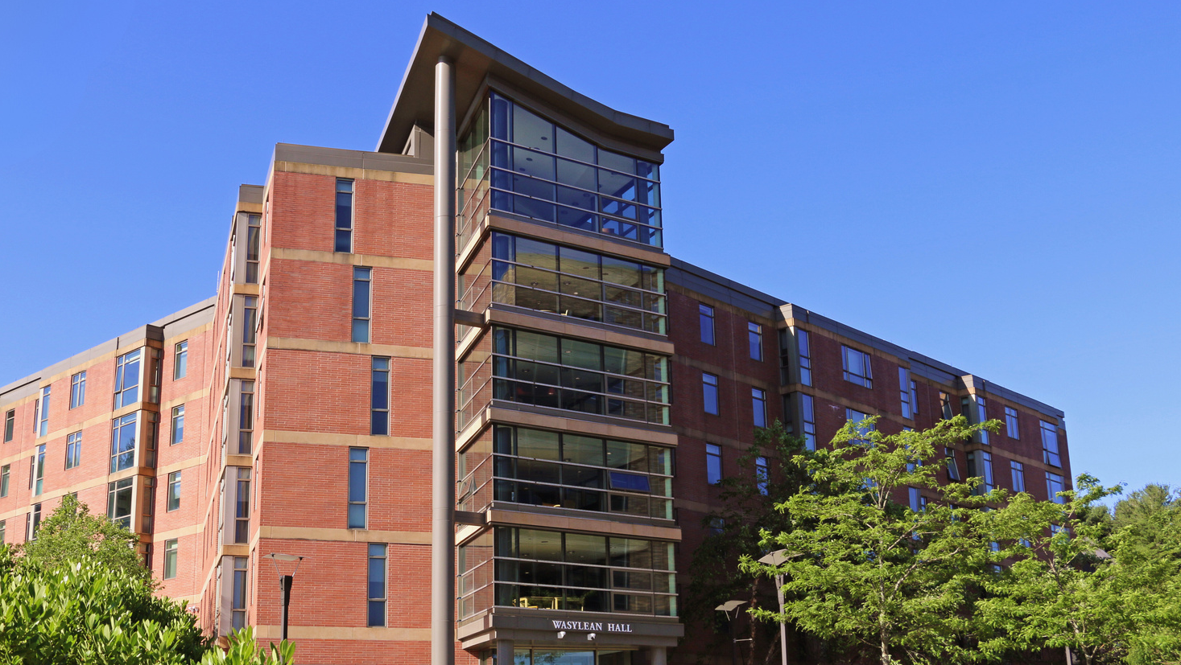
INSERT TITLE
Social Media Strategy
NAME
TITLE
DATE

Slide 2
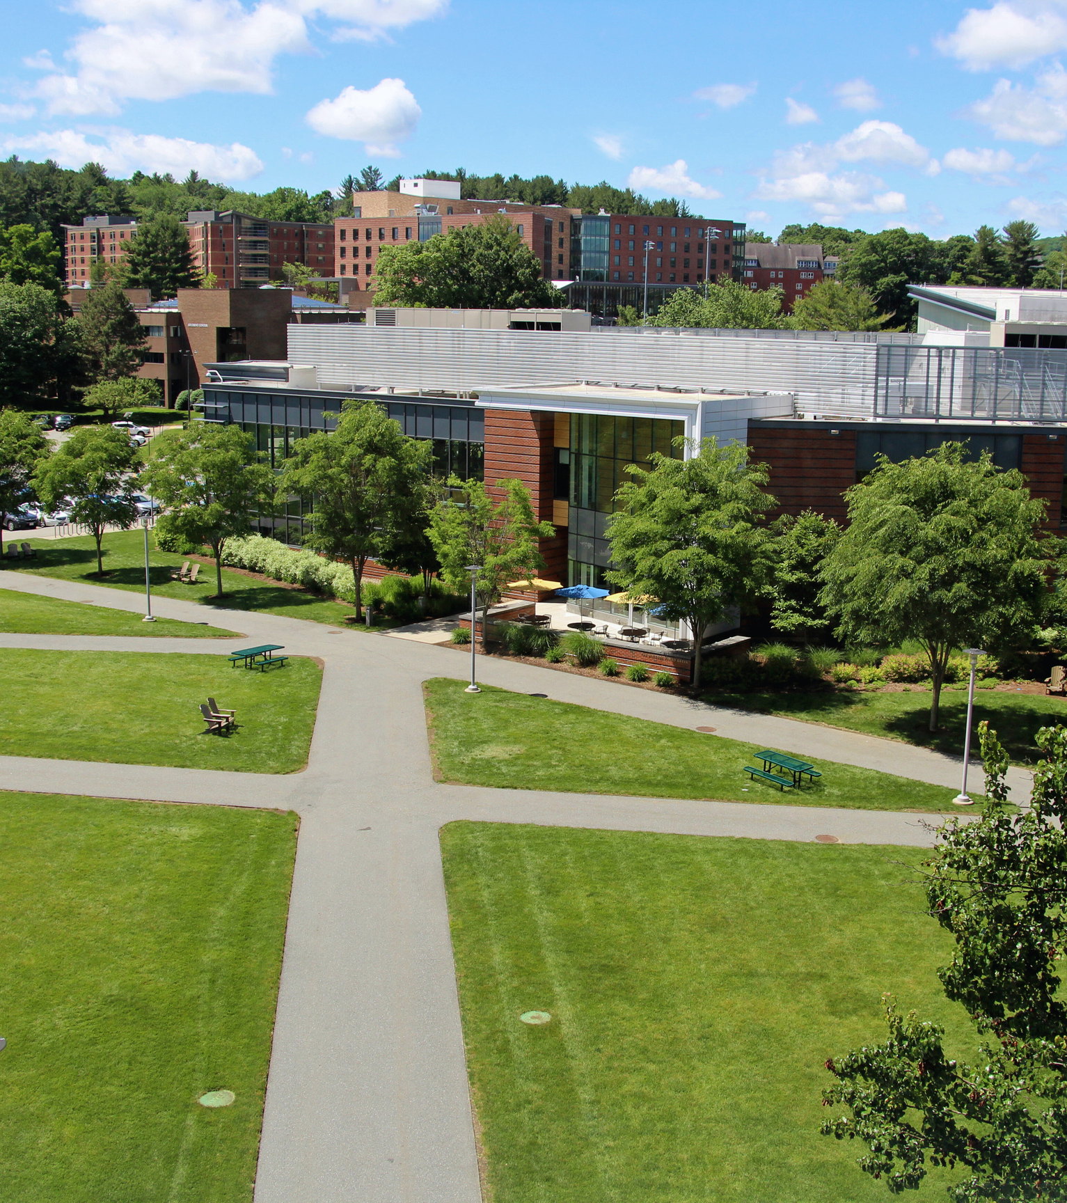
Executive Summary
Provide a brief synopsis of your social media strategy plan and what this document will outline.

Slide 3
Target Audiences

Slide 4
Knowing who your audience is and what they want to see is key to creating content that they will like, share, and comment on.
In the next slide, we have outlined the key and secondary audiences for our main Worcester State marketing accounts. Not all of these audiences may be applicable to your department or group. Adjust and add to this list to define your channel’s target audiences.
* Delete Slide

Slide 5
Key Audiences
Prospective Students
Traditional Students
Transfer Students
Graduate Students
Non-traditional Students
Parents and families
Current Students
Alumni
Donors and Funders
Secondary Audiences
Faculty and Staff
Current
Prospective
Local Community

Slide 6
Social Media Goals

Slide 7
Set goals for what you want to achieve through your social media efforts. These goals should keep your audience in mind and align with your department's or group’s objectives.
Once you have your goal selected, further define the strategy for how you will reach it.
You’ll then need to decide how you’ll measure your progress. For more information and examples of KPI, visit our blog, “A Guide to Measuring Social Media Success.”
* Delete Slide

Slide 8
Social Media Goals
We will:
Example: Increase Brand Awareness & Familiarity:
Enhance the university’s visibility and recognition among prospective students, parents, and community.
1
Strategy:
Share engaging and informative content that highlights the university’s programs, campus life, student achievements, faculty expertise, and community involvement.
KPI’s:
Follower growth, post reach, impressions, and brand mentions.
Goal #2
Description of goal
2
Strategy:
Description of strategy that will be used.
KPI’s:
Social Media metrics to track goals

Slide 9
Social Media Goals
We will:
Goal #3
Description of goal
3
Strategy:
Description of strategy that will be used.
KPI’s:
Social Media metrics to track goals
Goal #4
Description of goal
4
Strategy:
Description of strategy that will be used.
KPI’s:
Social Media metrics to track goals

Slide 10
Social Media Audit

Slide 11
If you’re already using social media, take a step back and look at:
What’s working and what’s not
Who is engaging with you
What you can learn from your current performance
If you aren’t currently using social media, revisit this 6 months in!
* Delete Slide

Slide 12
Social Media Benchmarks
As of: INSERT DATE [Data from INSERT DATE RANGE]
Channel
Number of followers
# of Posts
Average engagement rate
Mentions
Reach
Instagram
Facebook
LinkedIn
TikTok

Slide 13
Social Media audit
Instagram
Facebook
What’s working:
What’s working:
What’s not working:
What’s not working:
Audience:
Audience:
Lessons / hypotheses:
Lessons / hypotheses:

Slide 14
Social Media audit
LinkedIn
TikTok
What’s working:
What’s working:
What’s not working:
What’s not working:
Audience:
Audience:
Lessons / hypotheses:
Lessons / hypotheses:

Slide 15
SWOT Analysis
Positive
Negative
Strengths
Weaknesses
What are your team’s or account’s strengths?
Eg. “Video and graphic expertise”
etc.
What are your weaknesses with your current content or as a social team?
Eg. “Low Instagram engagement”
etc.
Internal
Opportunities
Threats
What/where are there opportunities for you on social media?
Eg. “Competitors aren’t using Instagram Stories”
etc.
What are your group’s threats?
Eg. “Competitor Y has 2x our followers”
etc.
External

Slide 16
Competitive Analysis

Slide 17
Analyzing the social media presence of other similar programs, departments, or groups at other university’s or colleges can help inform your own strategy. Knowing what your competitors are doing well—and not so well—can help guide you and provide inspiration for your own content.
Take some time to analyze and reflect on these competitor accounts using the next few slides. We recommend looking at and analyzing at least 3 other accounts.
* Delete Slide

Slide 18
Networks Active
Number of followers
Strengths
Weaknesses
Content that resonates
[What do you like about what they’re doing? What do you wish you had thought of first?]
[Which kinds of posts have been successful? What resonates with you?]
[eg., Facebook, TikTok, etc.]
[eg., 15,000]
[What are some areas they aren’t doing so well?]
Competitor 1
Competitor 2
Competitor 3

Slide 19
Networks Active
Number of followers
Strengths
Weaknesses
Content that resonates
[What do you like about what they’re doing? What do you wish you had thought of first?]
[Which kinds of posts have been successful? What resonates with you?]
[eg., Facebook, TikTok, etc.]
[eg., 15,000]
[What are some areas they aren’t doing so well?]
Competitor 4
Competitor 5
Competitor 6

Slide 20
Content Strategy

Slide 21
Determine your content mix by defining your content pillars. Content pillars are the main topics or themes that a brand focuses on, uses as the foundation of their content strategy, and helps guide them in what to post about.
When scheduling content, keep these pillars in mind to make sure you have a good mix of topics and content types.
As an example, we’ve included the pillars used for our main Worcester State marketing channels.
* Delete Slide

Slide 22
Content Pillars
Campus Life and Community Engagement
Academic Excellence and Opportunities
Engaging and Entertaining
Alumni and Connections
Showcases the vibrant campus life, student organizations, events, and the overall sense of community at Worcester State.
Highlights the university’s academic programs, faculty achievements, research opportunities, and student success stories.
Provide fun, relatable, and interactive content to keep the university community entertained and engaged.
Celebrating the accomplishments of alumni and fostering a strong alumni network.
Post Ideas
Post Ideas
Post Ideas
Post Ideas
Coverage of campus events, student activities, and clubs
Stories about student experiences
Posts about campus facilities, dining options, and student services
Features on community service and outreach programs
Spotlights on different academic departments and programs
Faculty interviews and achievements
Student research projects
Information about new courses, workshops, and educational resources
Interactive polls, quizzes, and challenges related to campus life and general interests.
Behind-the-scenes looks at campus events and day-to-day activities
Student-gathered content such as memes, TikToks, and vlogs
Photo/caption contests
Lighthearted/humorous posts
Alumni success stories and career achievements
Opportunities for current students to connect with alumni
Career advice for current students
* Work in conjunction with the alumni accounts

Slide 23
Content Pillars
Content Pillar #1
Content Pillar #2
Content Pillar #3
Content Pillar #4
Post Ideas
Post Ideas
Post Ideas
Post Ideas

Slide 24
Social Media Management

Slide 25
To successfully manage your accounts, it’s helpful to define a working process for your team and/or account manager. As an example, we’ve included our working process. These may vary for your needs, but you may see some overlap here.
* Delete Slide

Slide 26
Tasks to be handled by Social Media Manager
Daily Tasks
Monthly Tasks
Quarterly Tasks
1. Content Posting
1. Content Planning
1. Strategy Review
Post content according to the content calendar.
Plan and create content for the upcoming month.
Ensure a good mix of content types and topics
Review and update the social media strategy based on performance data.
Set goals and KPIs for the upcoming quarter.
* Majority of content will be scheduled ahead of time using Agorapulse
2. Engagement
2. Scheduling
2. In-Depth Analytics
Use Agorapulse to schedule posts for the month.
Ensure a consistent posting schedule across all platforms
Conduct a comprehensive analysis of performance metrics.
Identify trends, insights, and areas for improvement.
Respond to comments, messages, and mentions.
Engage with followers by liking, commenting, and sharing relevant content.
3. Reporting
3. Training and Development
3. Monitoring
Prepare monthly performance reports summarizing key metrics.
Analyze monthly data to identify successful content and areas for improvement.
Stay updated with the latest social media trends, tools, and best practices.
Attend webinars, workshops, or courses for professional development.
Monitor social media channels for brand mentions
4. Trend Watching
4. Competitor Analysis
4. Social Media Users Groups
Stay updated with trending topics and news in the industry.
Adapt content to leverage trending topics where appropriate.
Review competitors’ social media activities.
Identify successful strategies and content types used by competitors.
Hold quarterly meetings with the campus’ social media users group.
Discuss requested topics, brainstorm ideas, and align on goals and strategies.

Slide 27
Tasks to be handled by Social Media Manager
Daily Tasks
Monthly Tasks
Quarterly Tasks
1.
1.
1.
2.
2.
2.
3.
3.
3.
4.
4.
4.

Slide 28
Resources
Social media content calendar:
[Add Link to calendar— this maps out individual posts for each social network, along with visuals, links, copy, etc.]

Slide 29
Next Steps

Slide 30
Use analytics tools to measure how you’re performing against the goals, objectives, and KPI’s you set earlier.
Once you’ve compiled data, create slides highlighting key learnings and next steps.
* Delete Slide

Slide 31
Action Items
To Do
When
[eg., Improve accessibility of content by including alt. captions on all posts]
[eg., implement immediately]

Slide 32
Progress Update
Date range:
Channel
Net Followers Gain/Loss
# of Posts
Engagement rate
Mentions
Reach
Instagram
Facebook
LinkedIn
TikTok

Slide 33
What should we continue doing?
[Social Network]
[Social Network]
What’s Working:
What’s Working:
Why is it working:
Why is it working:
Action Items:
Action Items:

Slide 34
What should we stop doing?
[Social Network]
[Social Network]
What’s Working:
What’s Working:
Why is it working:
Why is it working:
Action Items:
Action Items:

Slide 35
What should we start doing?
[Social Network]
[Social Network]
What’s Working:
What’s Working:
Why is it working:
Why is it working:
Action Items:
Action Items:

Slide 36
Overall, fostering meaningful engagement on social media is our goal.

